Slide 1


Slide 2


zgodba

Slide 3
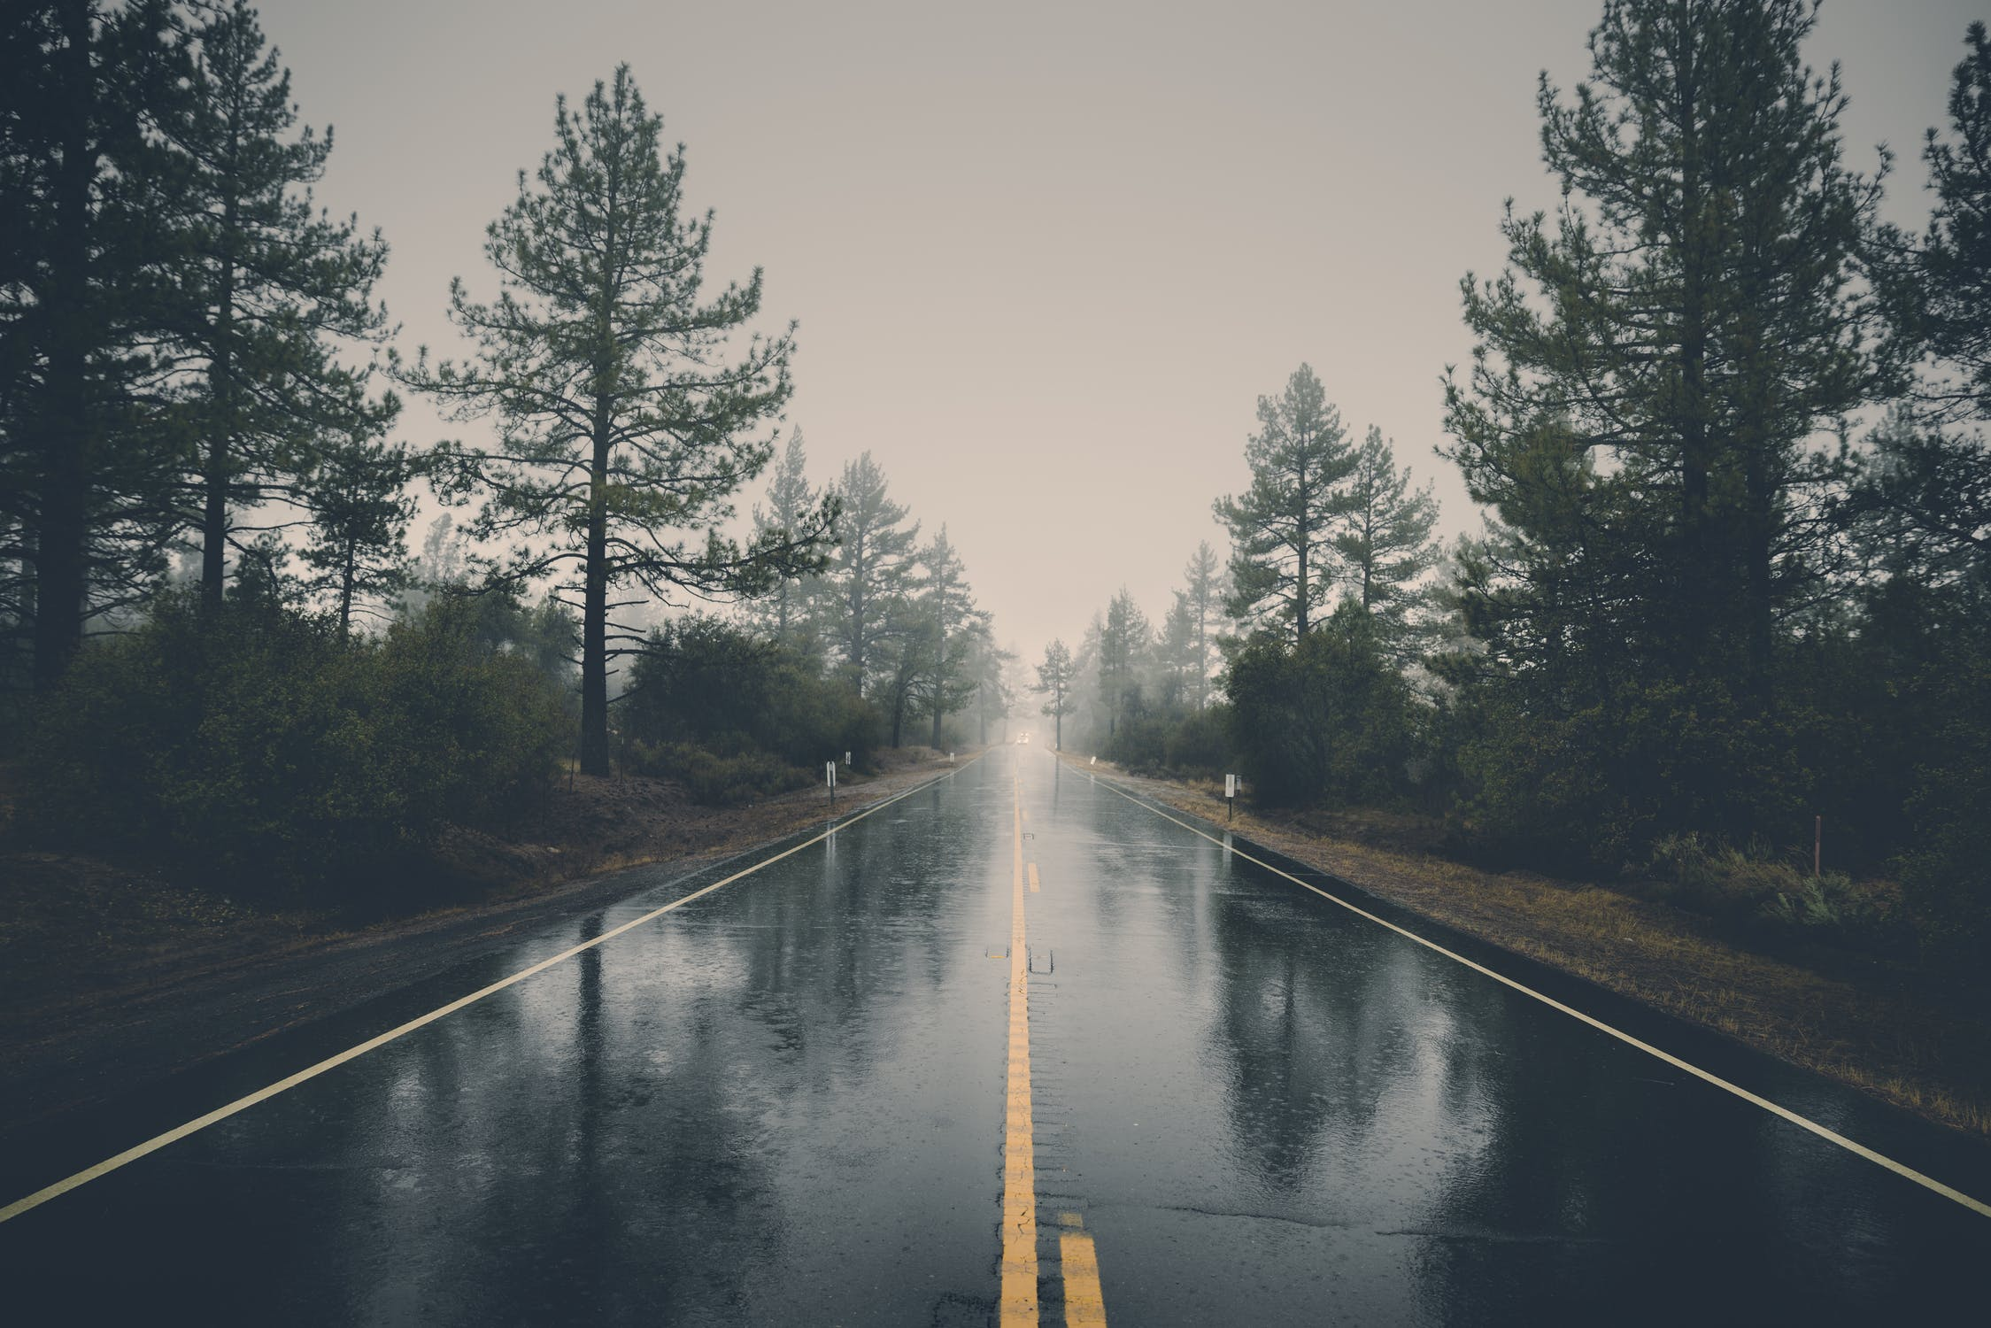
Extreme environment phenomenons
Drastic weather changes
Missing on rare beautiful scenery

Slide 4
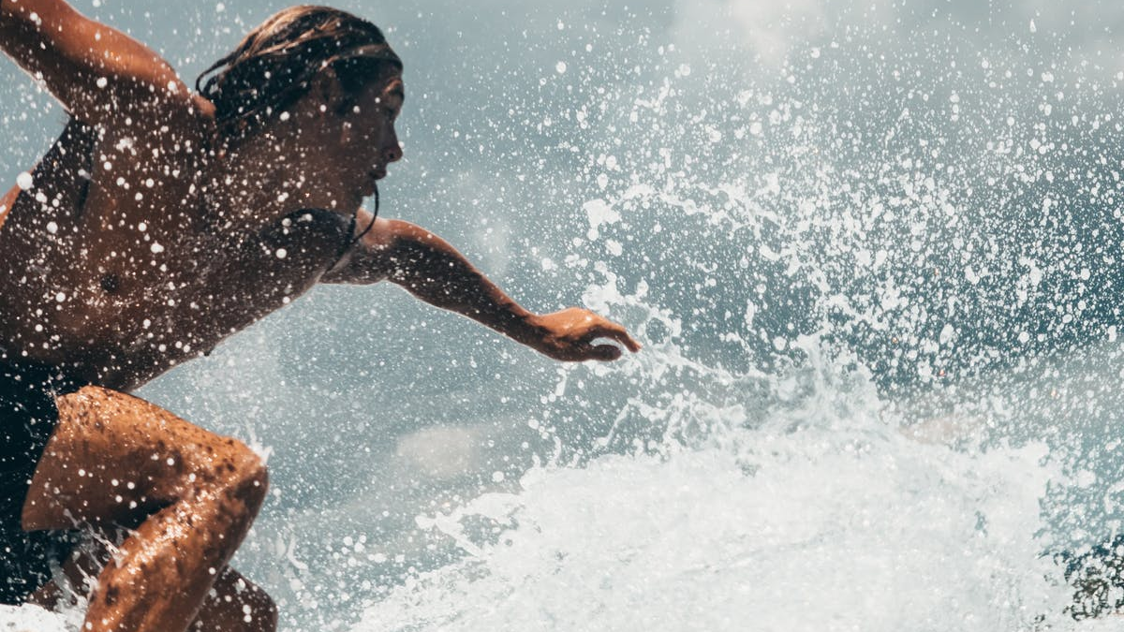
Active and passionate individuals
Explorers
Nature Enthusiasts
Adventurers

Slide 5
Live demo

Slide 7
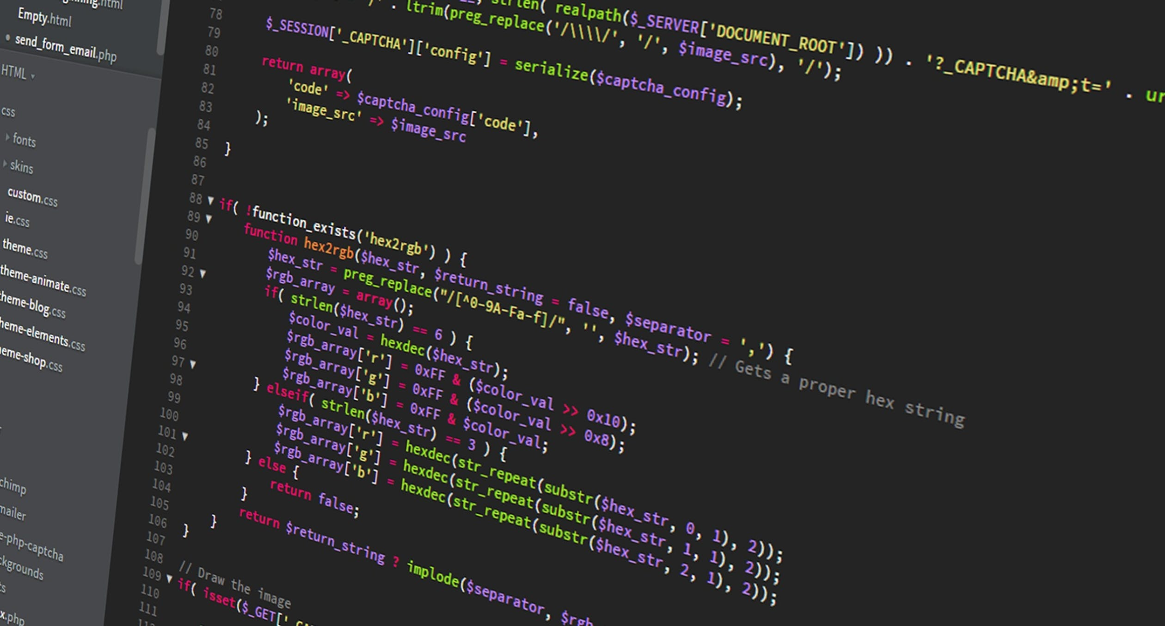
Technology & Design
Simplicity & Ease of use
Front end React & Back end Python
Leaflet map calling Sentinel Hub satellite service
Destination info provided by back end
Tequila widget for best deal
Back end & Tequila API for closest airport

Slide 8

Value proposition
Generation new leads
Bringing value to our transport and accomodation partners

Slide 9
What’s next
Obtaining information from social media
Connecting different types of transportation
Adding more tools for investigating temporal data
Improving UI/UX to follow our simplicity & ease of use guidelines

Slide 10
Thank you
Team Strange Birds

